Slide 1
Grab Snap
Luke Swanson, Bob Effinger

Slide 2

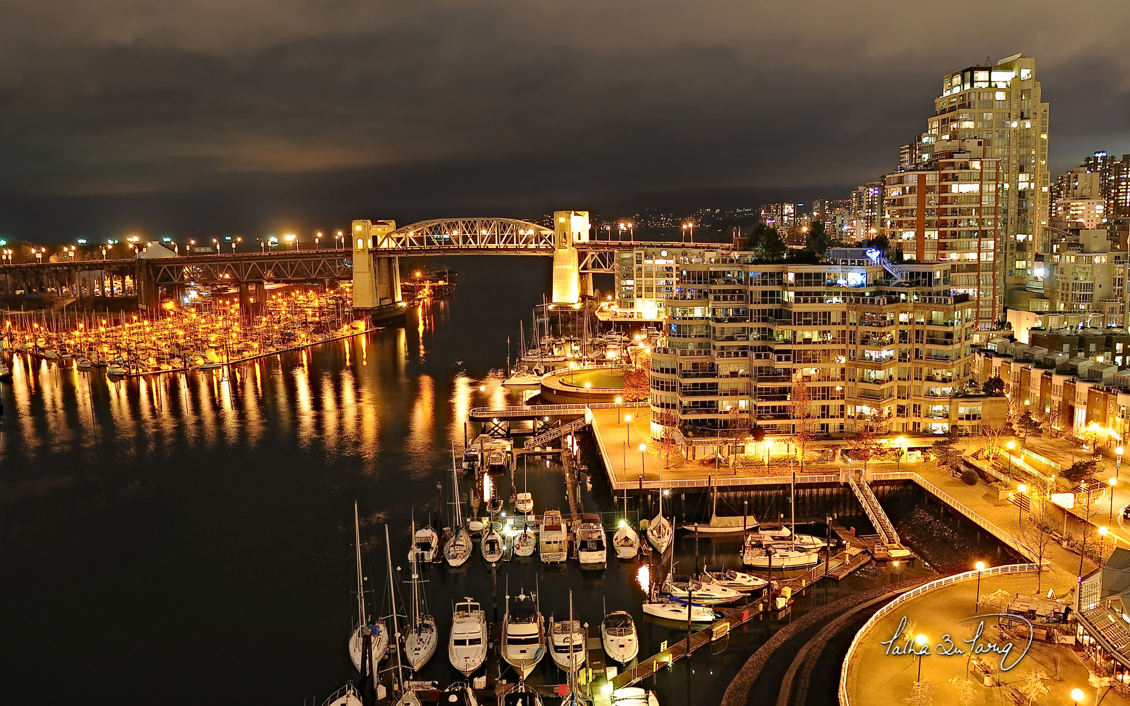

Image Segmentation
Image Credit: Blender Foundation
Image Credit: Talha Bin Tariq
Why it is useful
What does it look like

Slide 3
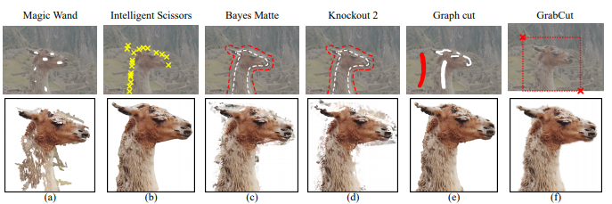
Automatic Segmentation Tools
http://pages.cs.wisc.edu/~dyer/cs534-fall11/papers/grabcut-rother.pdf

Slide 4
State of the Art:
Deep Image Matting: Use of deep learning to determine the matte of an image
Soft Scissors: Alternate Algorithm that pays closer attention to edge details

Slide 5
Graph Cut
Max-flow/Min-cut Algorithm:
Edges from terminals to pixels
Edges between neighboring pixels
Edge Weighting:
Terminal Edges weighted by “region” fit
Pixel Edges weighted by similarity
Sink
Source

Slide 6
What we want to do Differently
http://pages.cs.wisc.edu/~dyer/cs534-fall11/papers/grabcut-rother.pdf

Slide 7
Pipeline
Initialization:
-Trimap initialized using box drawn by user, Alphas are set equal to Trimap upon initialization
-Gaussian Mixture Models initialized using foreground and background pixels
Iterations:
-Each Pixel is assigned to a foreground or background component based on Alphas
-Gaussian Mixture Models refit to new pixel components
-Graph Cut used to determine if pixels belong in foreground or background
-Alphas are updated

Slide 8
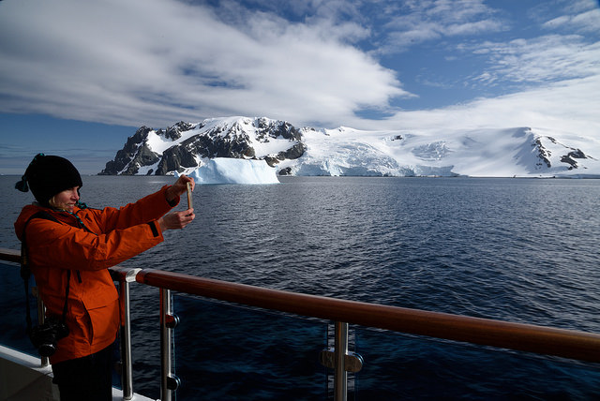


Trimap
Original Image
Initial Trimap
0 = Background
1 = Undecided
2 = Foreground
Image Credit: Scott Ableman
User-Refined Trimap

Slide 9

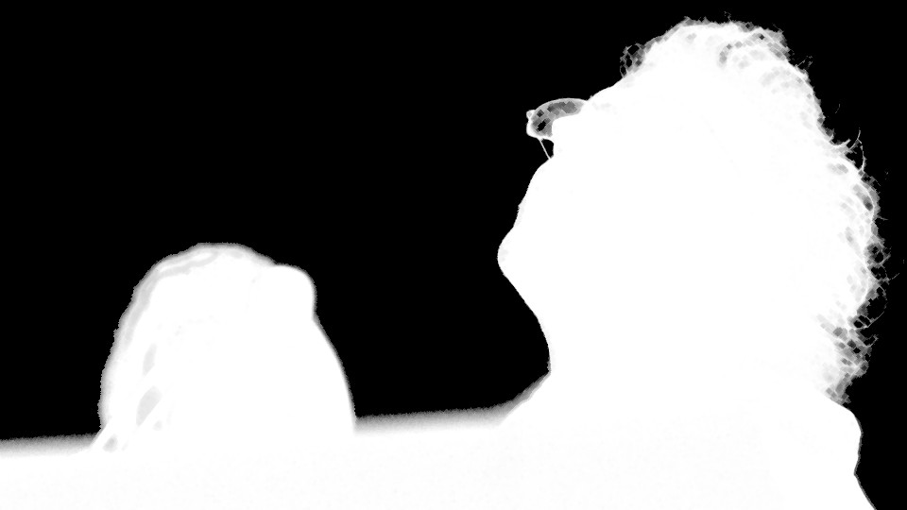
Alpha Mapping
Alpha = 1: Foreground/Undecided Pixel
Alpha = 0: Background Pixel
Alphas are Updated, while Trimap remains Consistent
Image Credit: Blender Foundation

Slide 10
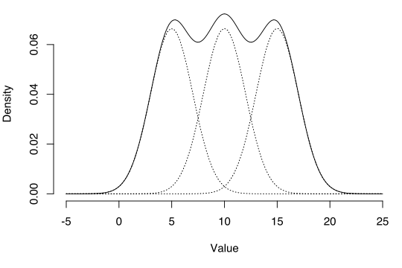
Gaussian Mixture Model (GMM)
A GMM helps us to group our pixels based the pixel features
Our algorithm uses RGB values, however other values could be used for different results
https://commons.wikimedia.org/wiki/File:Gaussian-mixture-example.svg

Slide 11
Results

Slide 12
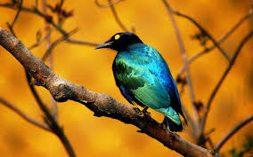

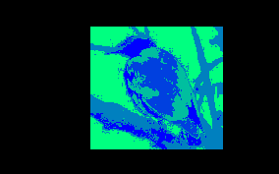
Img source : http://wallpaper-gallery.net/gallery/high-contrast-wallpaper.html
Initial K-Mappings

Slide 13






Grab Snap High Contrast Image

Slide 14

Changes over time

Slide 15




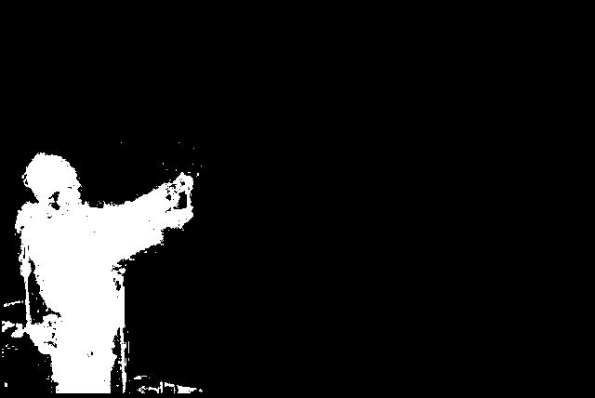





User Edits to Trimap

Slide 16


Changes with User Edits over Time

Slide 17
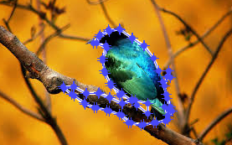
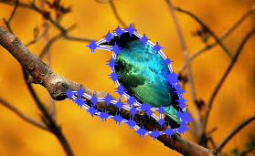
Border Edits
Pre-Border Edits
Post Border Edits

Slide 18
Issues
Images with low contrast between foreground and background
Picking number of components
Time Costs

Slide 19
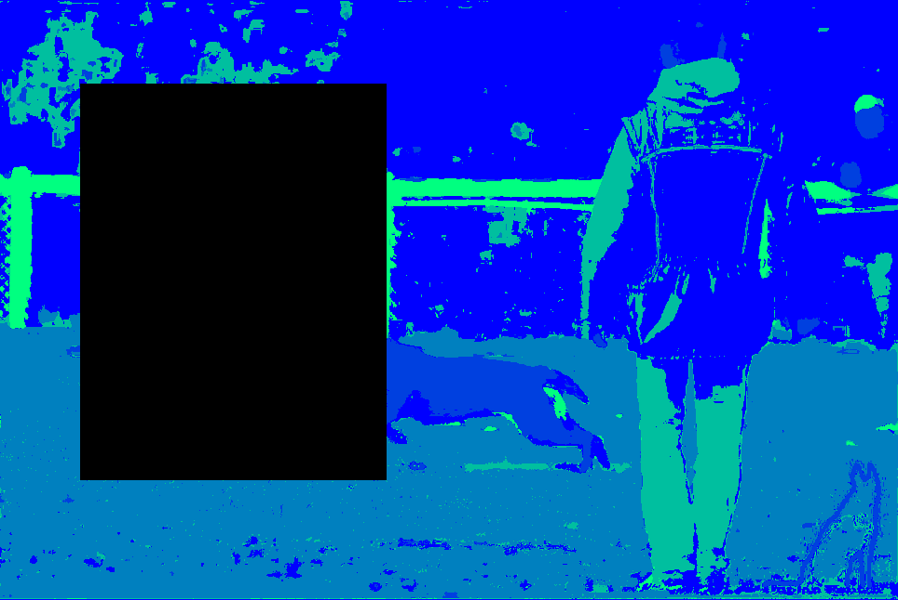
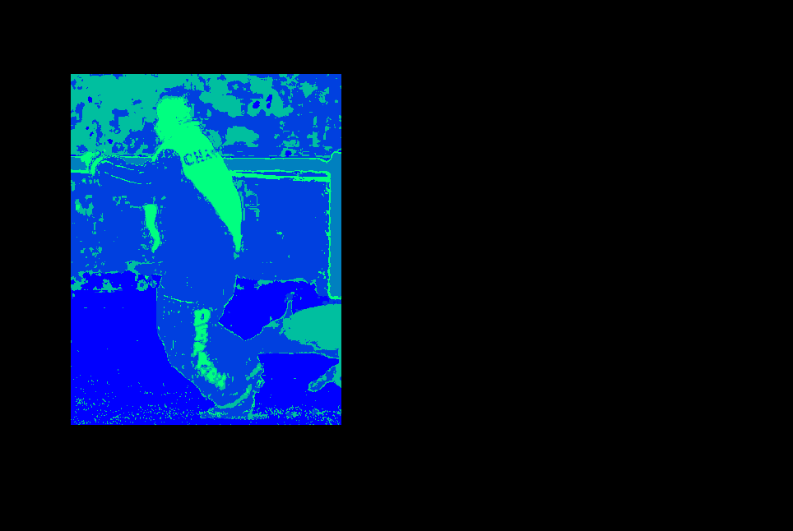
Poor Foreground Distinction

Slide 20
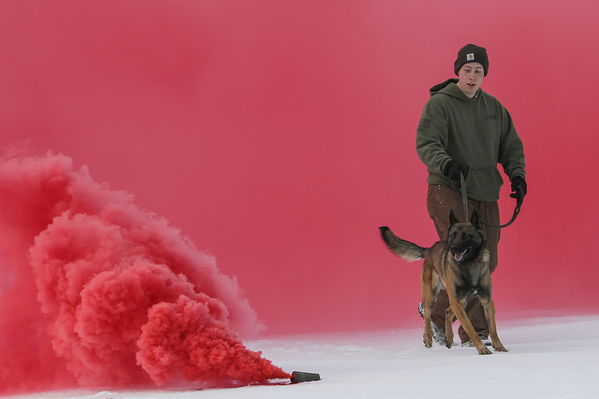

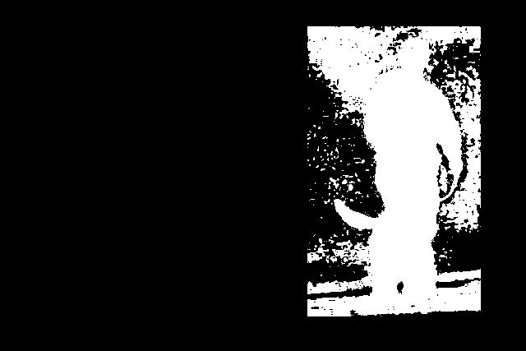
Picking Number of Components
Image Credit: Arctic Warrior (Flickr User)
Segmentation with 2 Components
Segmentation with 5 Components
If k is too small: Error due to “ill-conditioned” covariance in GMM component.
If k is too big: Error due to empty components.

Slide 21
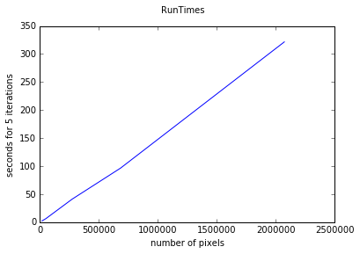
Time Costs
In order for this to be usable, users likely would want a fast run time, but the iterative convergence of this algorithm may interfere with user workflow
num pixels | Time for 5 Iterations
17423 (133x 131) | 2.262846 seconds
50268 (284 x 177) | 6.261734 seconds
273280 (640 x 427) | 41.069325 seconds
685000 (1000 x 685) | 96.599664 seconds
2073600 (1920 x 1080) | 321.642143 seconds

Slide 22
Future Work
Tuning of Hyper-Parameters
lambda (region weight)
gamma (smoothness weight)
Border Matting
Color Matching
Increase User-Friendliness
Different Programming Language/UI Toolbox

Slide 23
References
http://pages.cs.wisc.edu/~dyer/cs534-fall11/papers/grabcut-rother.pdf
https://www.microsoft.com/en-us/research/wp-content/uploads/2016/02/lazysnapping_siggraph04.pdf

Slide 24
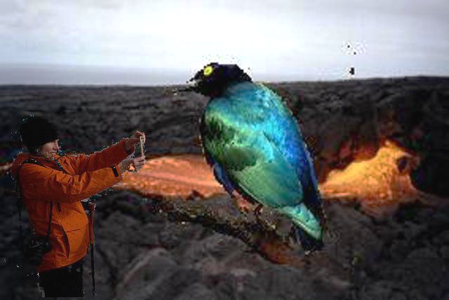
Questions?
Background Image Credit: Schizoform (Flickr user)

